Slide 1
The Predictability of an NBA Player
by:
Nahin Hayat
Christian Hernandez
Monica Estrada

Slide 2
Summary and Goals
Deep Learning Model which predicts NBA Player’s stats
One model predicts points, another predicts assists
Used for sports betting, i.e, over/unders

Slide 3
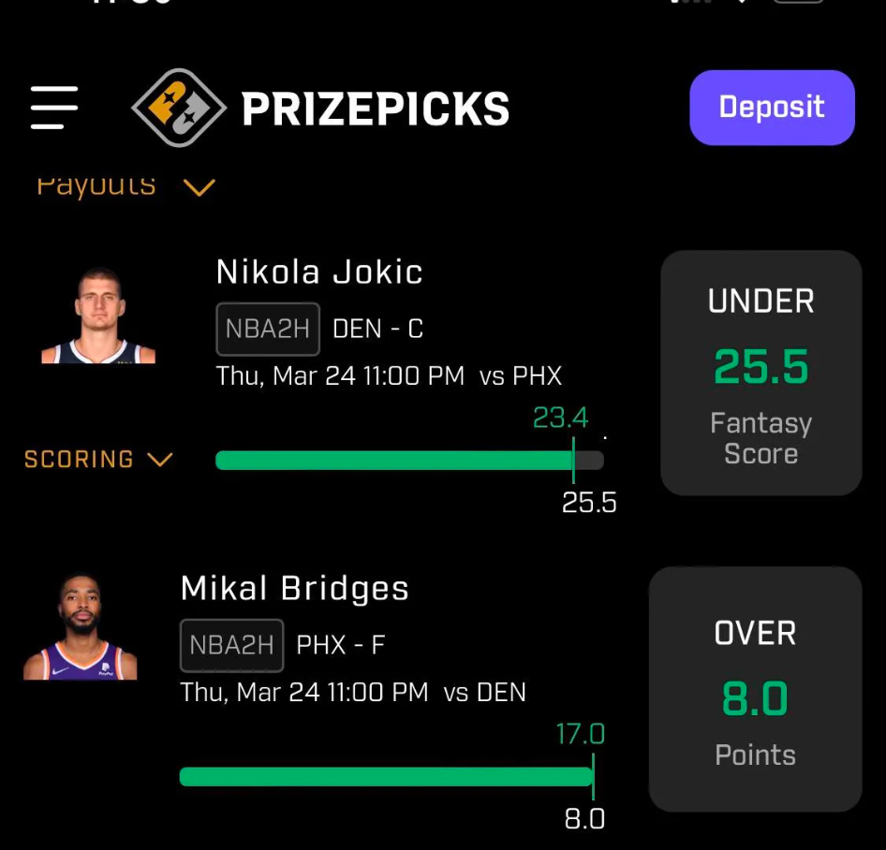
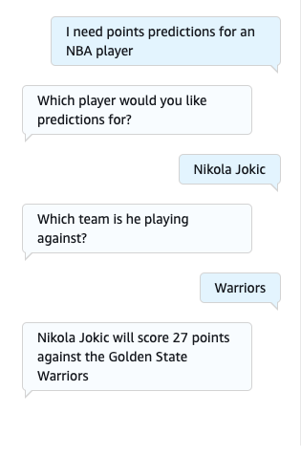
Points

Slide 4
Data Preparation and Model Training
Data was sourced from BasketBall Reference and StatMuse
Extensive Cleanup process
Trained with different layers and epochs for each model

Slide 5
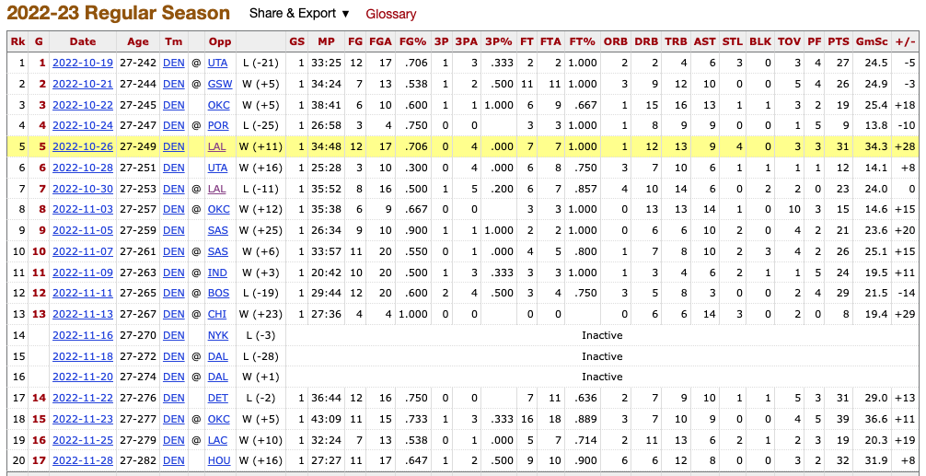

Slide 6
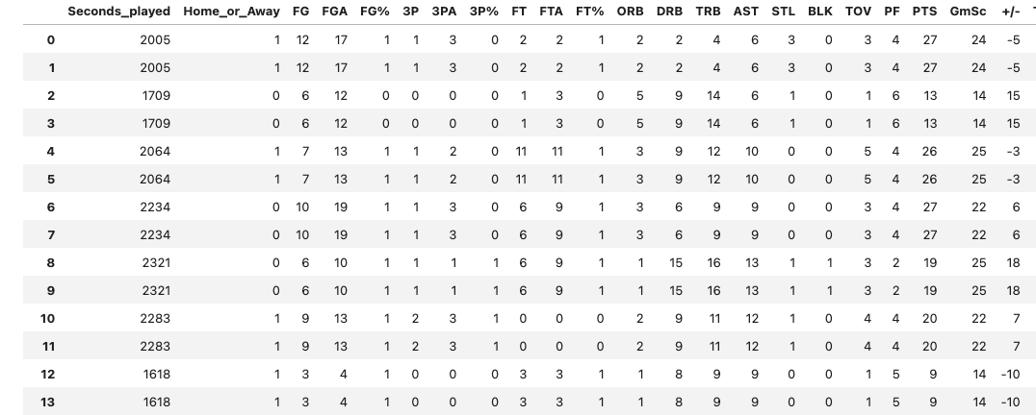

Slide 7
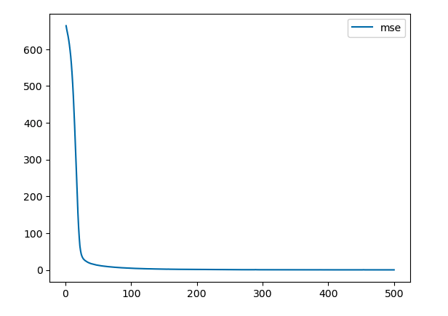
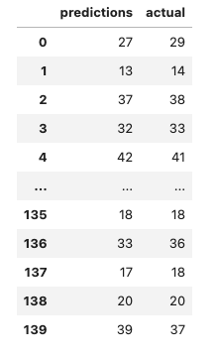
Points Model MSE: .5528

Slide 8
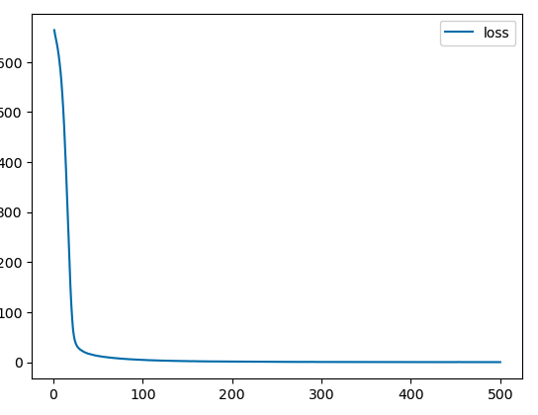
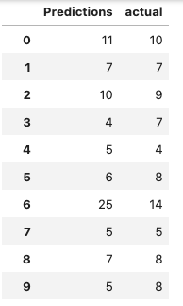
Assist Model MSE: 12.3321

Slide 9
Approach for Predicting Future Stats
Predictions were created by using previous averages
Dataframe for each conference

Slide 10
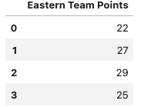
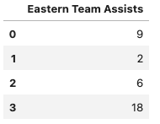
Eastern Conference Opponent Predictions

Slide 11
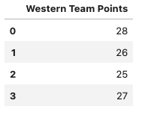
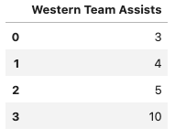
Western Conference Opponent Predictions

Slide 12
Next Steps
Models for every player
Make predictions using datasets of past games with specific opponent
Predict other stats
Dedicated Chat Bot

Slide 13
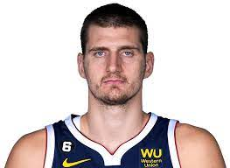
Thank you!
How did you know how much I was scoring before I even played, bro?

